Slide 1
CORPORATE PRESENTATION

Slide 2
Advanced Materials for advanced technologies
We are an Advanced Materials Company engaged in the design and manufacture of ultra-high-performance quartz crucibles, quartz products and ceramic products. Our products are vital to the semiconductor industry, enabling the production of logic and memory chips, power control devices, and multiple systems for electric vehicles.

Slide 3
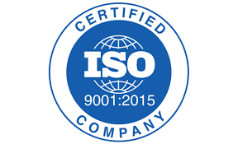
highlights
LEGACY
LEADERSHIP
INNOVATION
100+ year history in Quartz and Ceramics; 50+ years in Semiconductor; 20+ years in Aerospace/Military markets.
Recognized global leader in the supply of high-purity Quartz Materials, Crucibles and Ceramics Products.
Continuous innovation of high purity products for advanced semiconductor and high-power electronics.
POSSIBILITY
INTERNATIONAL
PARTNER
Critical materials enabling the realization and advancement of the Semiconductor industry.
Global manufacturing that provides business continuity capable of meeting current and future market needs.
Dedicated team focused on customer needs for quality, innovation and technical service.

Slide 4
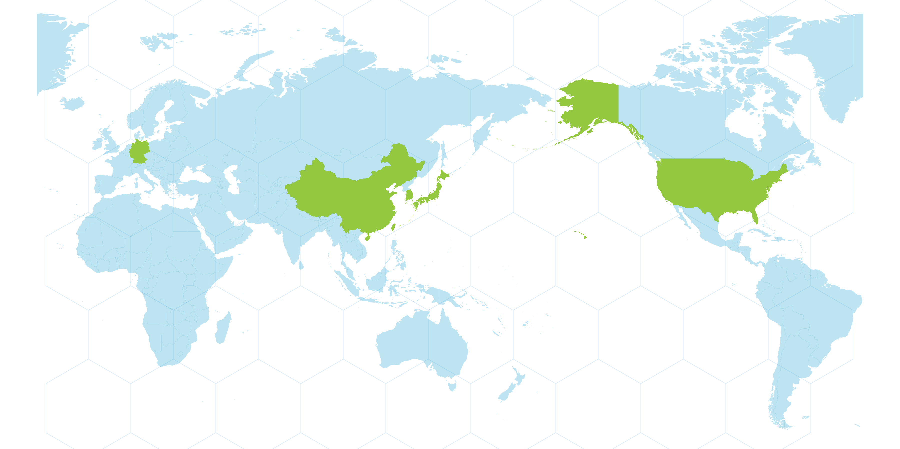
History of Innovation and Operational Excellence
130+ Years of History in Quartz and Ceramics
1891
Union Carbide formed to produce carbon & graphite for lighting & electric motors
1963
Union Carbide acquires High Temperature Materials Company
2002
Acquired by GE and renamed as GE Advanced Materials
2019
Momentive Technologies separated from Momentive Performance Materials
2025
Acquired Sibelco Spherical Alumina and Spherical Silica businesses
1946
Quartz tubing developed for GE Lighting
1993
Advanced Ceramics Corp. established from Union Carbide
2006
Acquired by Apollo PE and established as Momentive Performance Materials
2022
Acquired Crucibles business

Slide 5
GLOBAL presence – Manufacturing and sales
GERMANY
CHINA
USA
JAPAN
HQ
TAIWAN
KOREA
850+ Employees Worldwide
Manufacturing facility | Sales office

Slide 6
Excellence in advanced materials
World’s First – Gold Standard
First Large-Diameter Tubing
Supplier of record for industry standard quartz products
Global Market Leader
Quartz Solid Ingots
Quartz Crucibles for Silicon Ingot Production
CVD TaC for SiC Crystal and Epi Production
Quartz Tubes for Semiconductor fabricators
BN powders and Hot pressed BN in US market

Slide 7
Broad Market Presence (2023 Data)
Electronics Emphasis: ~85% of total revenue from products sold into the silicon semi and compound semi markets
Strong Market Channel: Serving IDM’s through to OEM’s and OEM supplier base
Robust Product Portfolio and Technology Pipeline: Target key electronic and industrial market segments
Customer Focus: Manufacturing, Sales and Marketing resources aligned to meet Customer Needs around the Globe

Slide 8
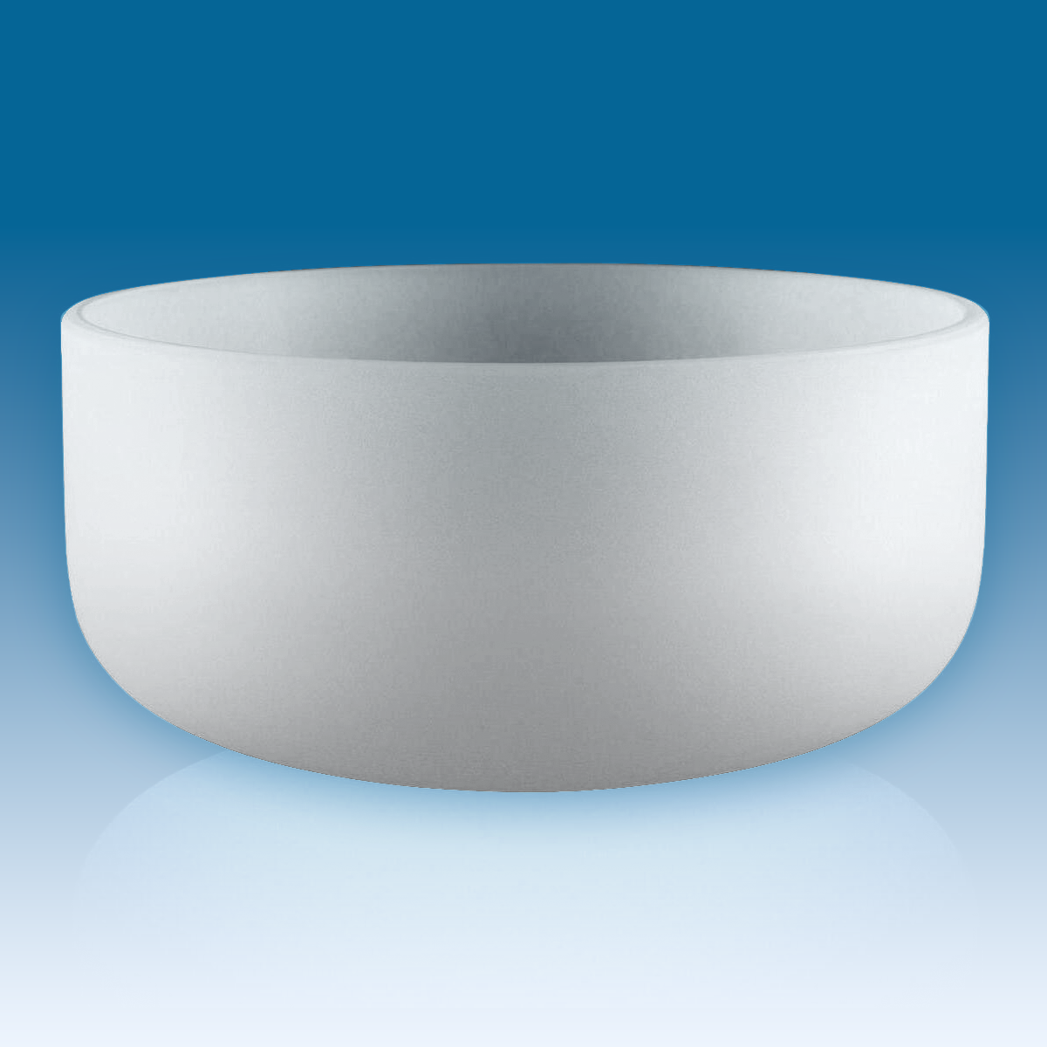
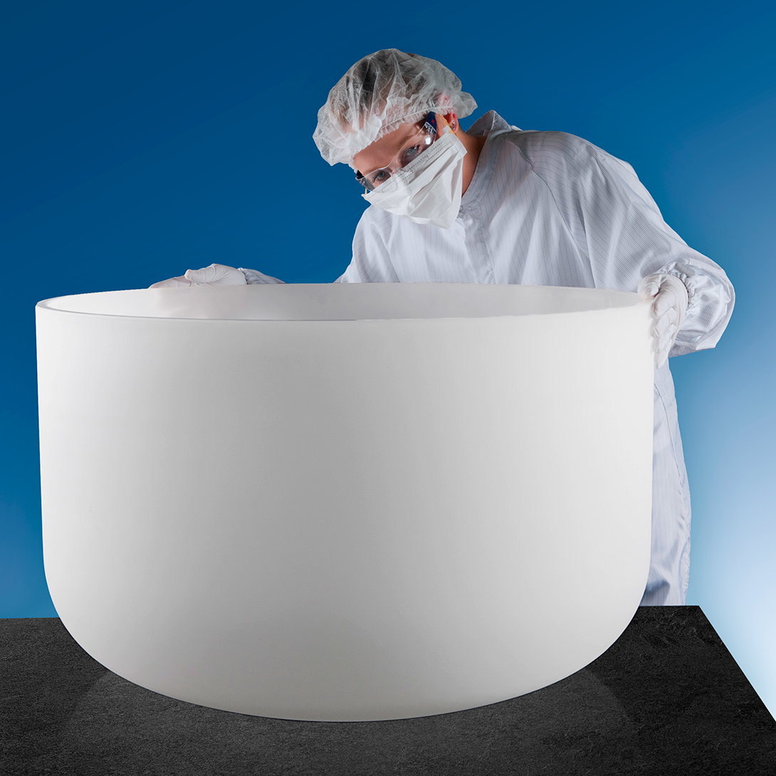
CRUCIBLES
In the manufacture of silicon wafers, polysilicon materials are placed in a fused quartz crucible, heated to high temperatures and pulled from the melt as a single crystal.
With three quartz production sites and proprietary sand processing facilities located in the U.S., Momentive Technologies is uniquely positioned to ensure the continuity of the semiconductor supply chain for critical quartz products
JAPAN PRODUCTS
GERMANY PRODUCTS
Diameters from 28" to 36"
Semiconductor Wafer Applications
Diameters from 14" to 32”
Semiconductor Wafer and Fabrication Applications

Slide 9
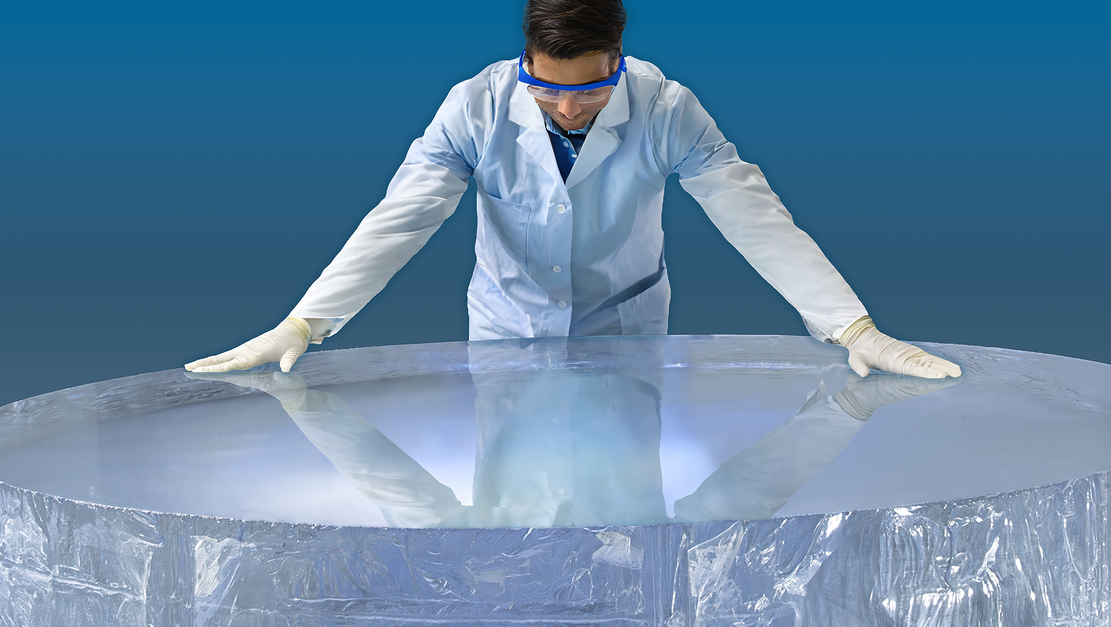
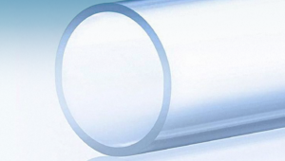
Quartz
Momentive Technologies is a global leader in fused quartz.
With three quartz production sites located in the U.S. and one site located in China, Momentive Technologies is uniquely positioned to ensure the continuity of the semiconductor supply chain for critical quartz products.
SOLIDS
TUBES and RODS
VIALS
Ingots
Extremely High Purity
Natural and Synthetic Sand
Low Hydroxyl
Low Aluminum/Alkali
Opaque Solids
Extremely High Purity
Natural and Synthetic Sand
3mm to 800mm in Diameters
Low Aluminum/Alkali
High UV-Transmission
Unrivaled Chemical Durability
Ultra-High Purity (>99.995% SiO2)
State-of-the-Art Tubing and Vial Manufacturing
Industry-Standard Sizes (2ml–50ml) and Tolerances
Proud FDA Emerging Technology Program Participant

Slide 10
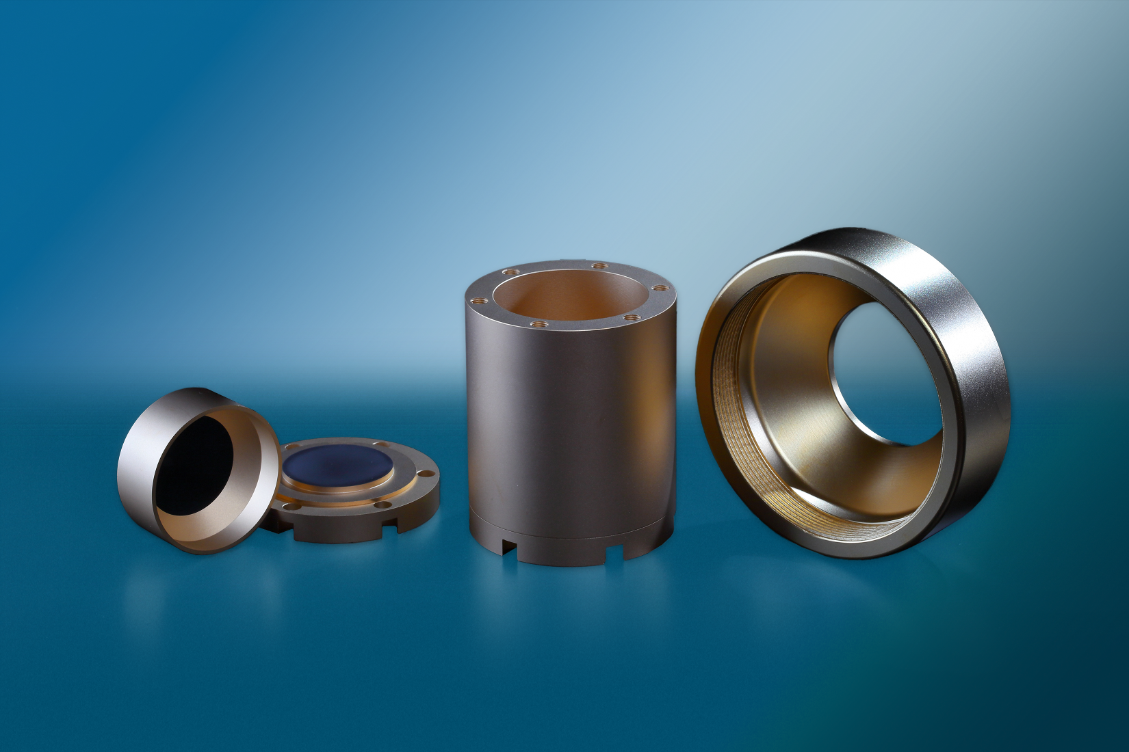
Ceramics
Technology is constantly evolving, and there is a continuous demand for the next best thing in terms of performance, strength, and sophistication.
Momentive Technologies is a global leader in advanced ceramic technology and designs solutions to meet the demands of the semiconductor industry.
COATINGS
POWDERS AND SOLIDS
Tantalum Carbide
Pyrolytic Boron Nitride
Pyrolytic Graphite
Boron Nitride Powders
Spherical Oxide Powders
Titanium Diboride Powders
Hot-Pressed Boron Nitride Shapes
Heaters, E-Chucks and Modules
High Thermal Conductivity Graphite Products
PBN Heaters and Chucks
TaC Heaters
Thermal Levelers
Modules
Thermal Pyrolytic Graphite
TC1050
TMP-EX
TMP-FX

Slide 11
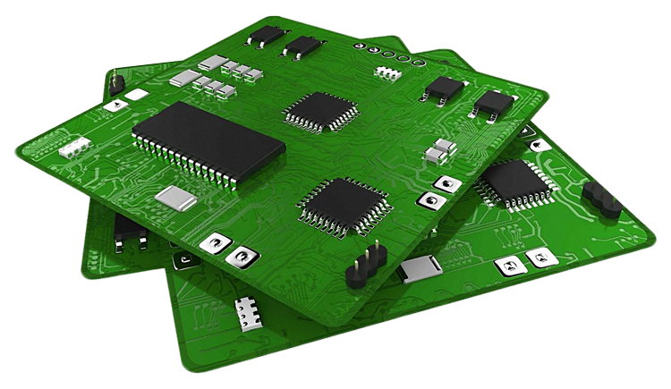
Silicon Semiconductor and compound Semiconductor Processes
INGOT
CRYSTAL GROWTH
BARE SI WAFER
DIE
SLICE INGOT
DICE WAFER AND PACKAGE
PACKAGED IC CHIP
MOUNT PACKAGE
PROCESSED WAFER
PROCESS WAFER IN SEMI LAB
FINAL CIRCUIT BOARD
Quartz Crucibles
Electrostatic Chucks
pBN Heaters
CMP Pads
ESC/Heater Assemblies
Chip-level Heatsinks
Board-level Heat Spreaders
TIM Greases and Adhesives
Printed and Flexible Circuit Boards
pBN Crucibles
Tantalum Carbide (TaC) Crucibles
Quartz Solids
Quartz Rods and Tubes
■ Crucibles | ■ Quartz | ■ Ceramics

Slide 12
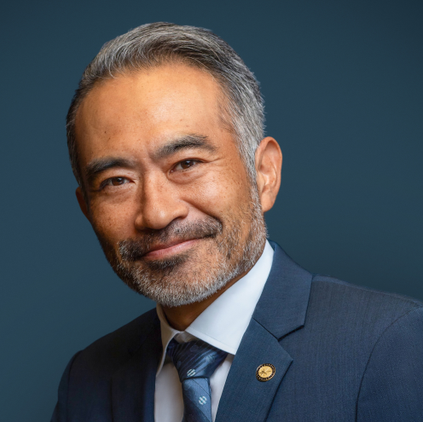
Experienced Leadership Team
MARK WOLF
Chang Bin Im
President and CEO
Chairman of the Board of Directors
Business Units
Operations/technology
BRETT BUFFA
DR. KAZUYA SAITO
BRIAN KOZAK
RAJA SODHI
MARTIN PANCHULA
DANIEL MOSSOP
Sr. VP, Quartz
VP, Crucibles
VP, Ceramics
VP, Global Operations
VP, CTO
VP, CIO
Corporate
RYAN CROSKEY
JEFF BARLOW
SEUNGKI MIN
SUE SUN-LASOVAGE
Sr. VP, CFO
Sr. VP, General Counsel
VP, Corporate Development
VP, Human Resources

Slide 13
Thank you

